Slide 1

Harvard Online Learning
May 21, 2014

Slide 2
What is the Learning Portal?
Provides a gateway for the public to gain access to Harvard’s extensive digital learning resources (from iTunes to SoundCloud to HarvardX)
Allows users to be just one click away from the learning experience.
Offers opportunities for learning content producers around the University to feature their content, driving traffic to School-based learning assets.
Gives online learners a continuum of options from free to paid with certificates or credit

Slide 3
Who is leading the effort?
Created under the auspices of the Office of the Vice Provost for Advances in Learning & Provost’s Office.
The core team for the DLP is comprised of members from FAS, Harvard Public Affairs and Communications, HarvardX, and DCE (with additional input from leads at the exec ed programs).
The soft launch is planned for Summer 2014 with a more public launch in the Fall

Slide 4
Goals
Assemble Harvard’s diverse and wide array of online learning in one, central place
Demonstrate multi-platform approach to digital learning.
Increase traffic along a continuum of free to fee.
Be attractive, with curated content and easy navigation and search, replacing obsolete tools and sites.
Represent “One Harvard.”
Eventually become self-service for content providers.

Slide 5
Content and categories
Content Sources:
HarvardX
School sites
DCE/Extension School paid courses
Extension School Open Courses
HBS Exec Ed
HKS Exec Ed
HGSE Exec Ed
HSPH Exec Ed
HLS Exec Ed/PON
iTunes U
YouTube EDU
SoundCloud
DASH
Harvard@Home
HMS Department of Continuing Education
Conversations@FAS
The Forum at HSPH
Great Teachers (FAS)
Institute of Politics JFK Forum
Woodberry Poetry Room
WIDE World (HGSE)
Usable Knowledge (HGSE)
Working Knowledge (HBS)
Life Sciences Outreach Program
Natural History Museum Lectures
Peabody Museum Lectures
Justice with Michael Sandel
Harvard Archives -
Harvard Library Digitized Resources
Content Categories:
Open Online Courses, Modules, and Sequences
  edX
  iTunes, YouTube
  PERSONA: Intellectually curious, learning for learning’s sake, may be persuaded to pay for a course
For-Credit Courses, Certificates, and Degrees
  Extension/Summer School
  HBX (?)
  HKS Executive Ed
  PERSONA: Employed and most likely studying for career purposes. Looking for Harvard credential and experience, academic credit, faculty interaction/assessment
Professional Development (on-campus, online, blended)
  HBX (?)
  DCE Professional Dev
  GSE (possibly)
  PERSONA: employed, looking to hone skills for work
Executive Education
  Schools
  PERSONA: Employed as exec, employer is paying for courses
Other Learning Materials

Slide 6
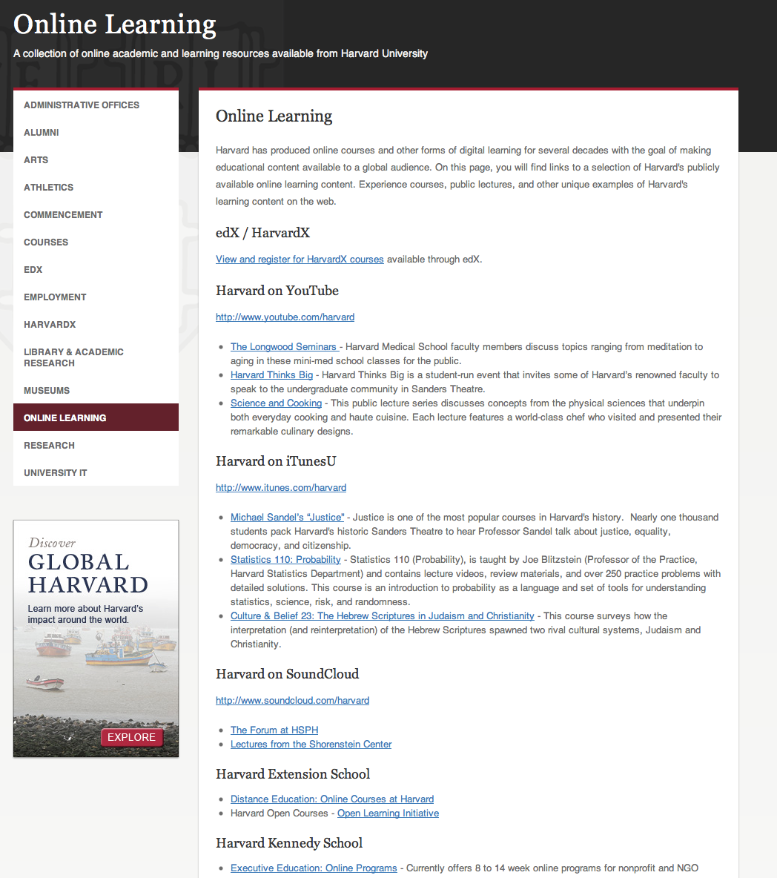
What we have now

Slide 7
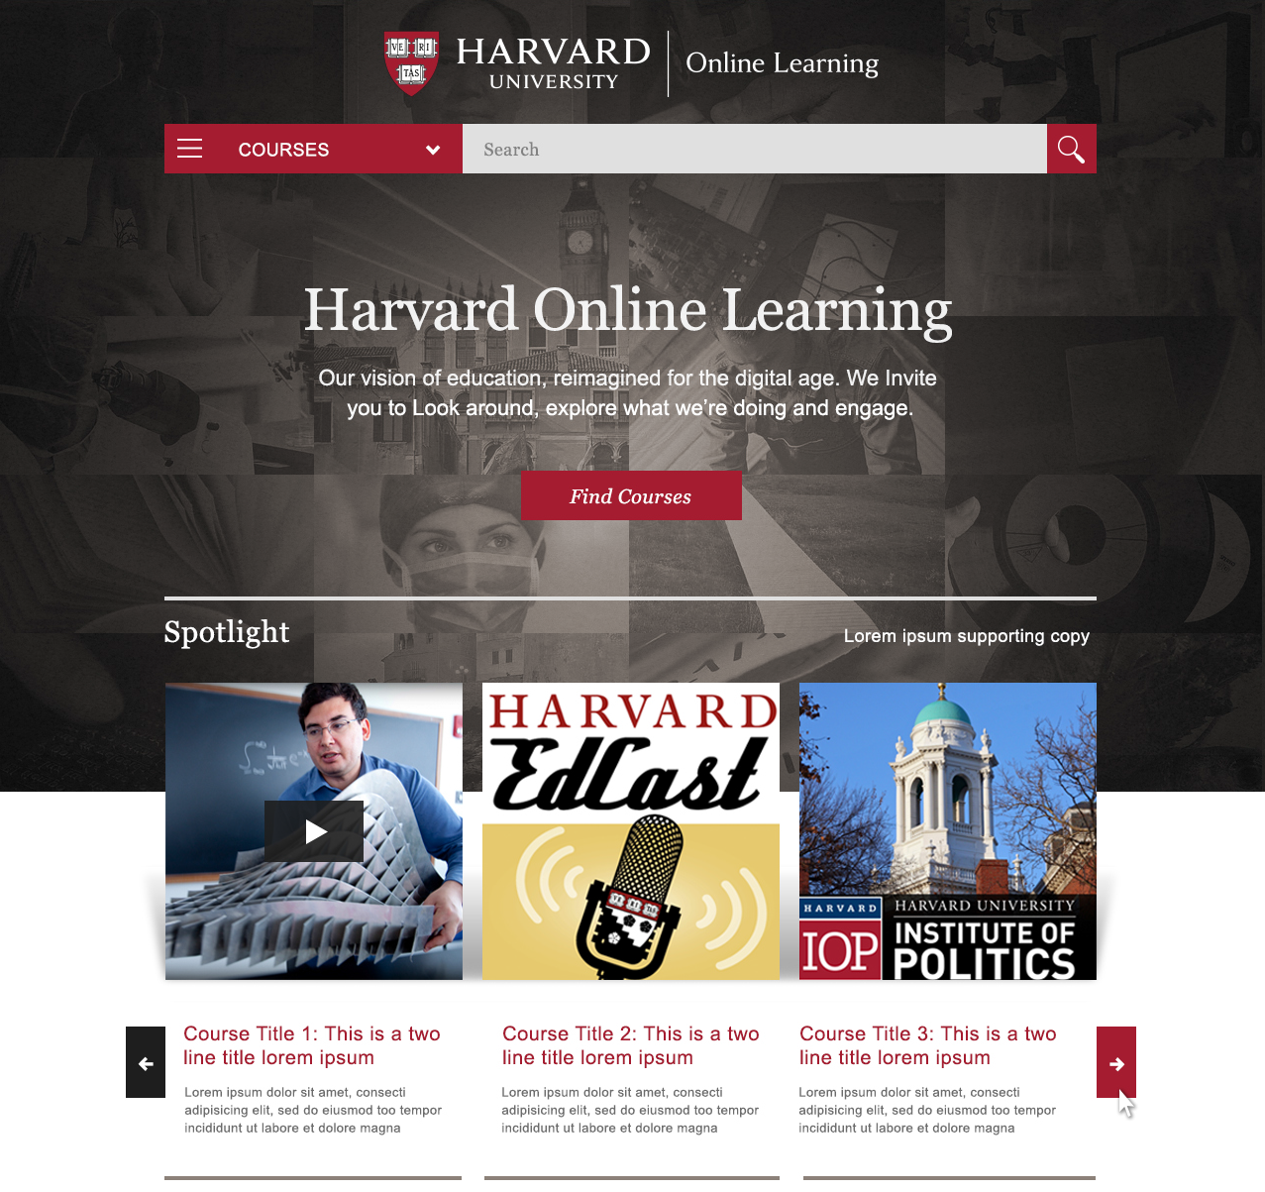
Notes:
Homepage design, including spotlight

Slide 8
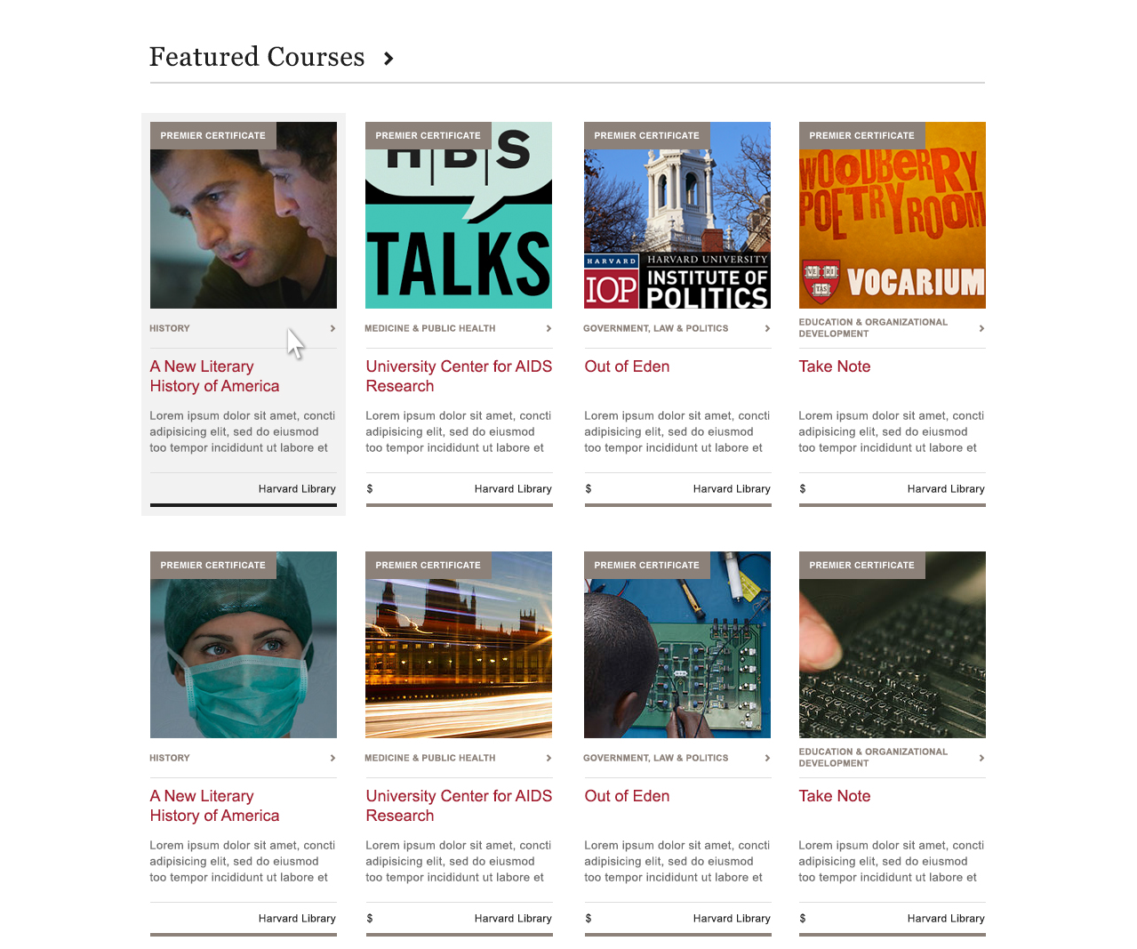
Notes:
Featured courses

Slide 9
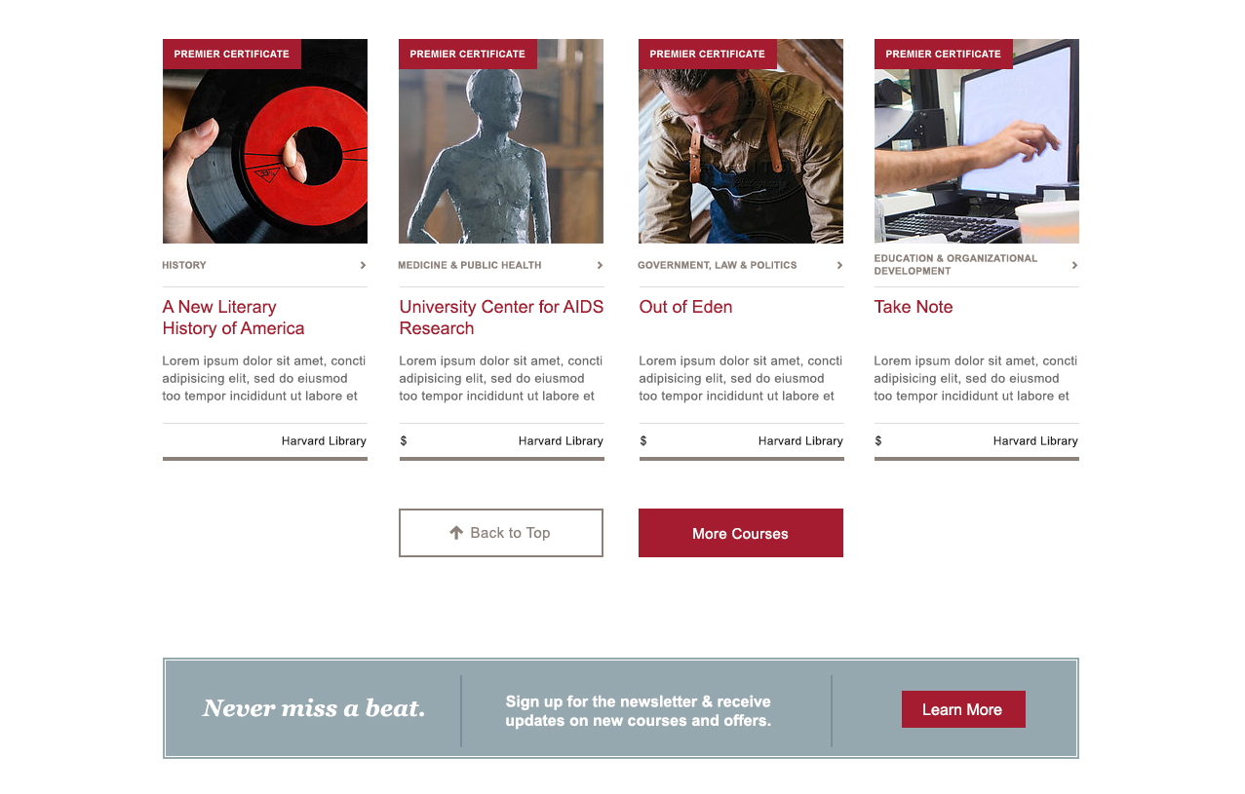
Notes:
Bottom of homepage. Selecting “More courses” button will load 20 more courses.

Slide 10
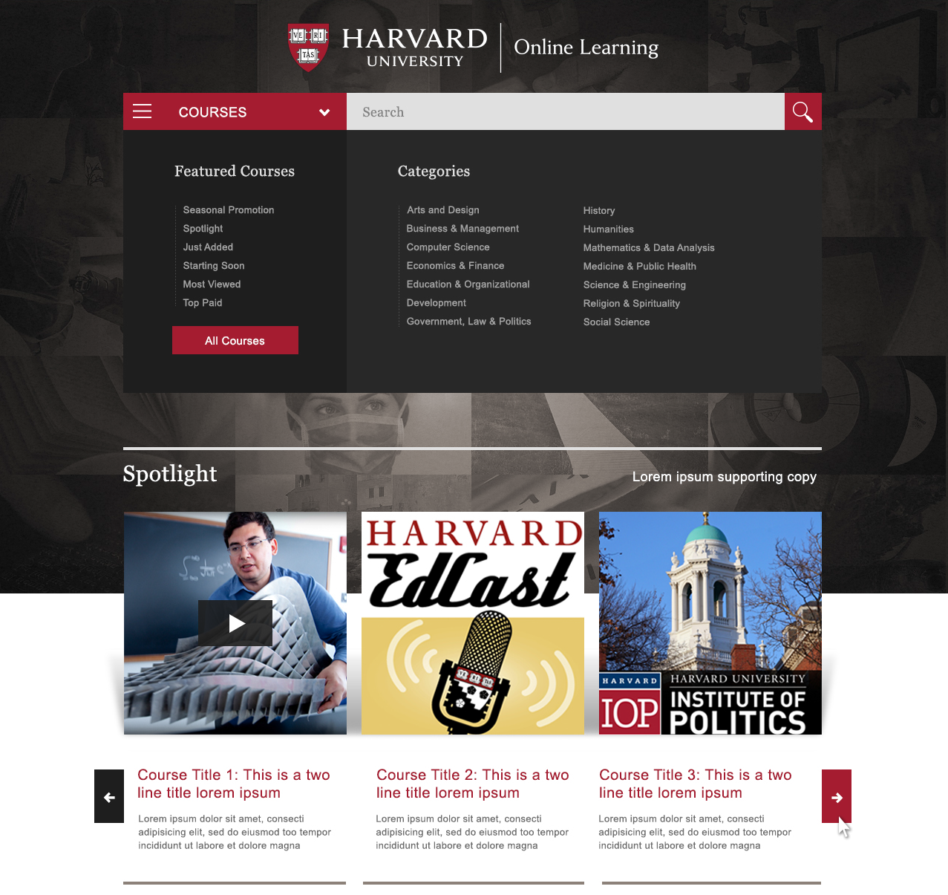
Notes:
Search feature at the top of the page, expanded to show featured courses and categories list

Slide 11
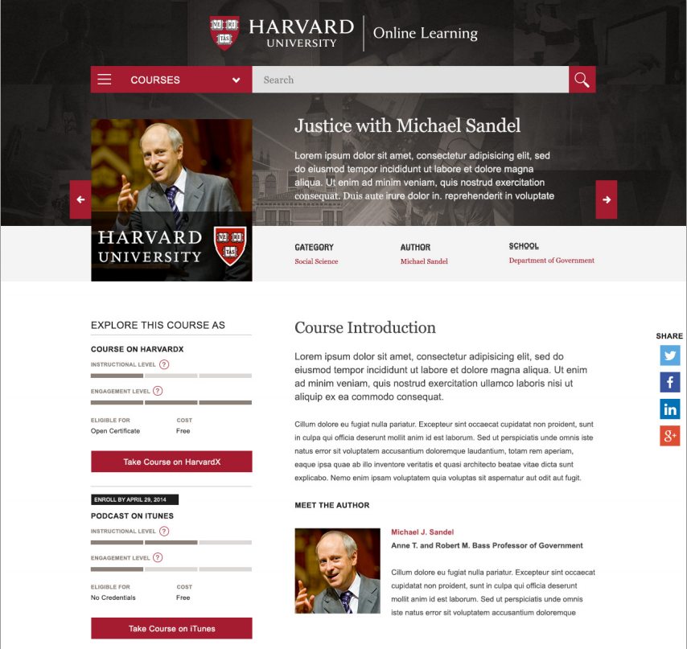
Notes:
Homepage design, including spotlight

Slide 12
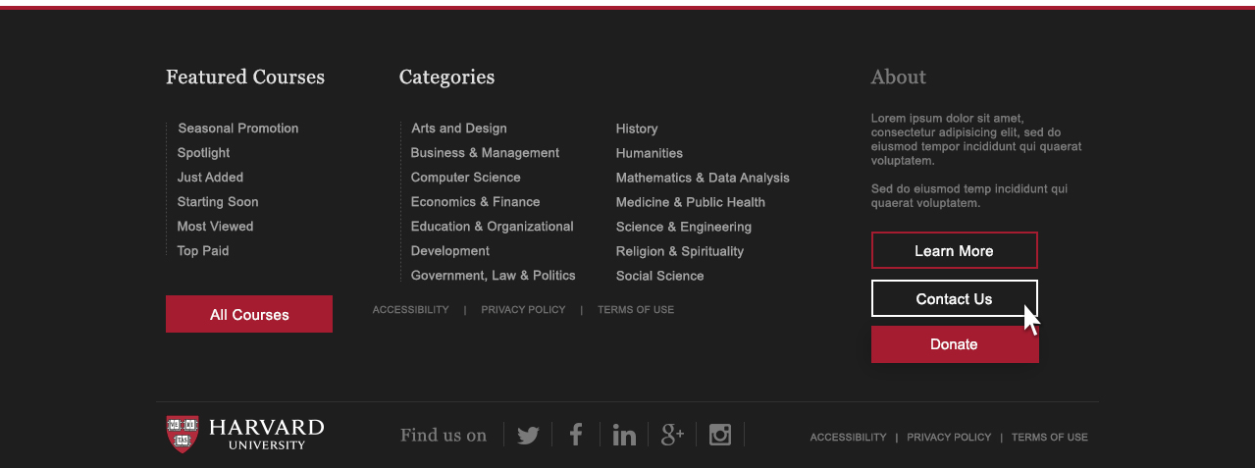
Notes:
Navigation at the bottom of the home page, including featured courses and the 13 categories, as well as “About” section. Three buttons for “Learn more”, “Contact Us”, and “Donate” may not be included with the initial launch.

Slide 13
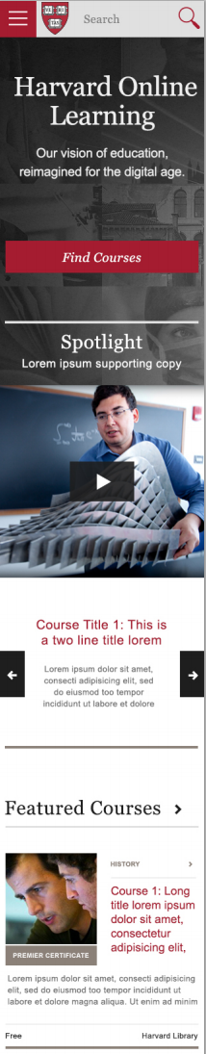
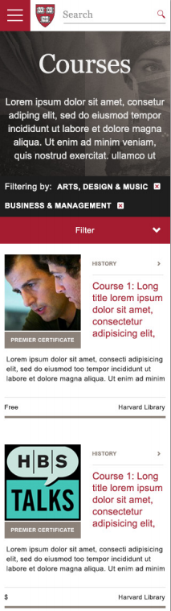
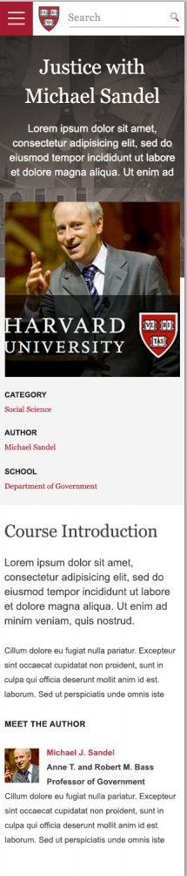
Notes:
Homepage design, including spotlight

Slide 14
Next Steps
Soft launch of site in August; public launch in the Fall
Internal communications throughout summer, broader communications in the Fall
Site to be managed by team from Digital Strategy and HarvardX
Phase 2 of site TBD
Those interested in contributing courses to the site can reach out to Ben Sharbaugh or Michael Rutter

